Slide 1
ASSIGNMENT 5
GROUP 1:
Merlin Mariam Thankachan (c0748721)
PROJECT TITLE : IOT BASED SMART PARKING USING BEAGLEBONE WIRELESS

Slide 2

Finalizing hardware requirements:
BEAGLEBONE BLACK WIRELESS
HC-SR04 ULTRASONIC SENSORS
ADAFRUIT ULTIMATE GPS BREAKOUT MODULE
ULN2003 DRIVER BOARD
28BYJ-48 STEPPER MOTOR
16x2 LCD DISPLAY
OTHER ACCESSORIES

Slide 3
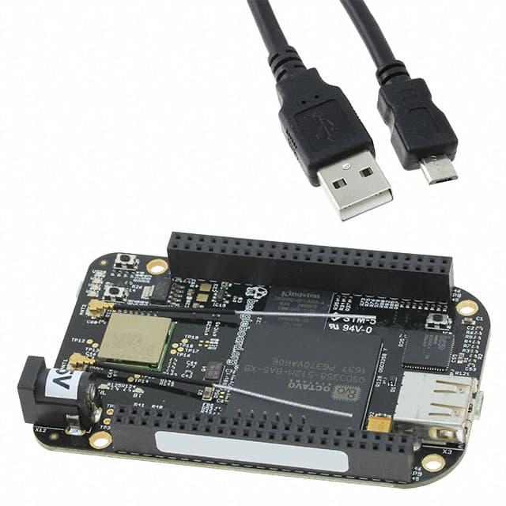
BEAGLEBONE black wireless
Works as the central processing unit
ARM Cortex-A8 processor can provide speed up to 1 GHZ
512MB DDR3 800MHZ RAM
4GB Embedded eMMC Flash with Debian Distribution
microSD Card Slot
Working Voltage : 3.3 V
WiLink 1835 802.11 2.4GHz WiFi, Bluetooth, and BLE connectivity are available
Micro HDMI output
2x 46 pin headers

Slide 4
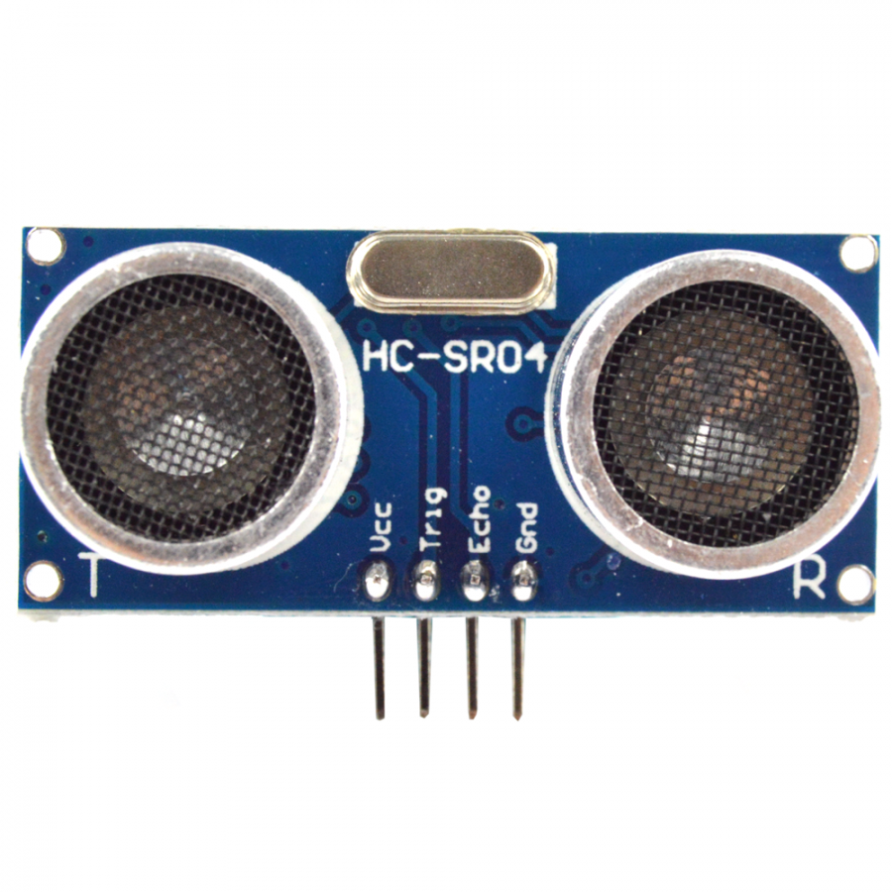
HC-SR04 ULTRASONIC SENSORS
To identify the presence of vehicle at entrance and parking lot.
Working voltage: 5v
Working frequency : 40 hz
Working current: 15mA
Range : 2cm - 4m
Ranging accuracy: 3mm

Slide 5
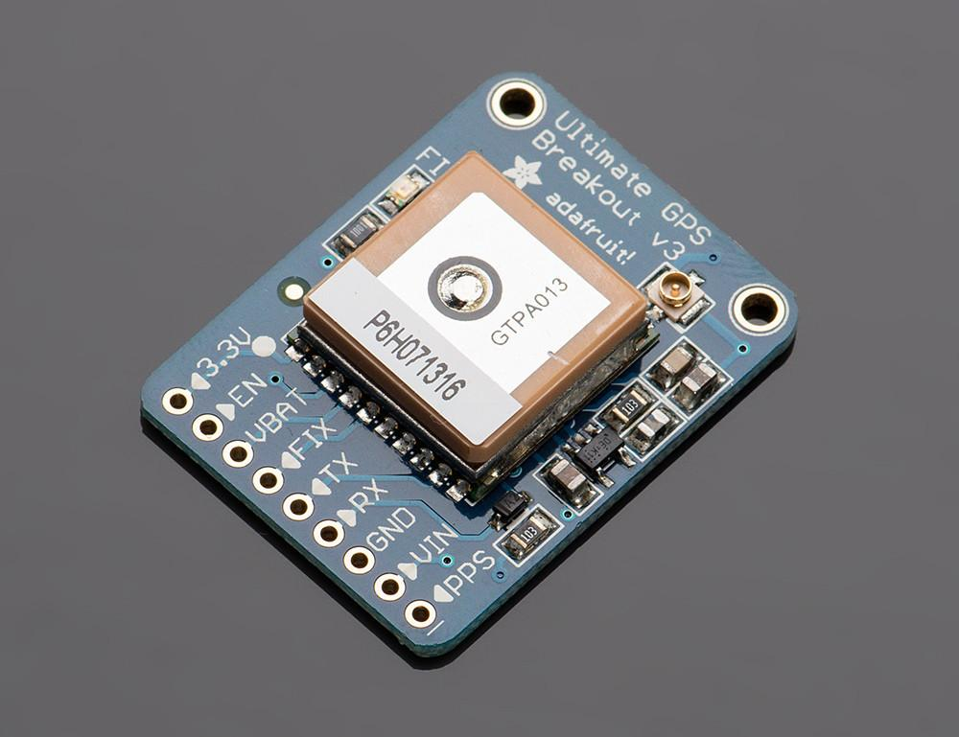
ADAFRUIT ULTIMATE GPS BREAKOUT MODULE
This is used to update the position of parking station
It have -165 dBm sensitivity, 10 Hz updates, 66 channels
Working voltage: 3.3v to 5v
Working current: 20mA
Position Accuracy: 1.8 meters

Slide 6
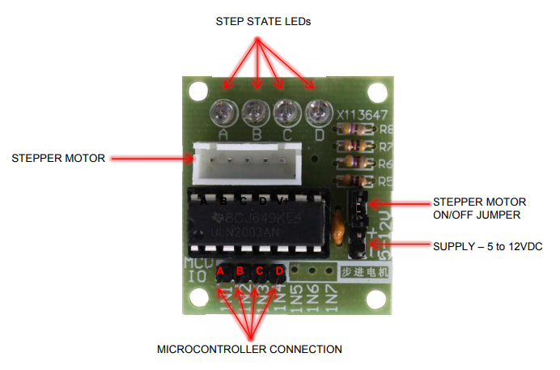
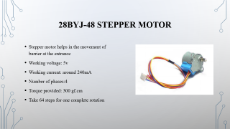
ULN2003 DRIVER board
This board is used to drive the stepper motor
ULN2003 gives a higher current gain
Input voltage: 5-12V
Output Voltage rating: up to 50V
Output Current rating: up to 500mA
The onboard socket is available to directly connect with 28BYJ-48 stepper motor

Slide 7
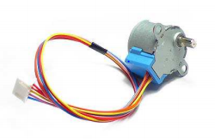
28BYJ-48 STEPPER MOTOR
Stepper motor helps in the movement of barrier at the entrance
Working voltage: 5v
Working current: around 240mA
Number of phases:4
Torque provided: 300 gf.cm
Take 64 steps for one complete rotation

Slide 8
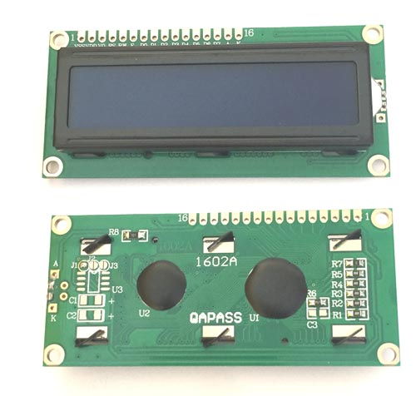
16x2 LCD DISPLAY
This is used at the entrance to display the available number of parking lots
Operating Voltage is 4.7V to 5.3V
Current consumption is 1mA
It has two rows and each row can print 16 characters
Can work on both 8-bit and 4-bit mode

Slide 9
Other Accessories
Power adapter: 5v, 10W power adapter is used to power up the system
Jumper wires: in order to make the connections
1K ohm resistors: used to reduce voltage from echo pin of ultrasonic sensors to interface with beaglebone GPIO
10 K ohm potentiometer: to control the contrast of LCD display
Dotted PCB board: in order to integrate the whole system

Slide 10
REFERENCES
Beaglebone.org (2019 Aug). BeagleBone Black Wireless retrieved from https://beagleboard.org/black-wireless
Component101 (2017 Sep). HC-SR04 Ultrasonic Sensor retrieved from https://components101.com/ultrasonic-sensor-working-pinout-datasheet
Adafruit (ND). Adafruit ultimate gps breakout - 66 channel w/10 hz updates retrieved from https://www.adafruit.com/product/746
Helen (2019). Dummies guide on driving a 28BYJ-48 Stepper Motor with a ULN2003 Driver Board and Arduino retrieved from https://www.seeedstudio.com/blog/2019/03/04/driving-a-28byj-48-stepper-motor-with-a-uln2003-driver-board-and-arduino/
Component101(2017 Aug). 16x2 LCD Module retrieved from https://components101.com/16x2-lcd-pinout-datasheet

